Slide 1
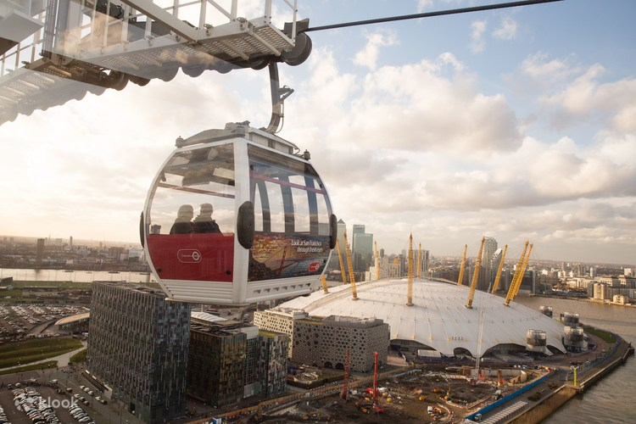
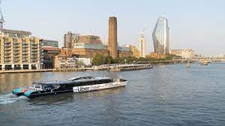
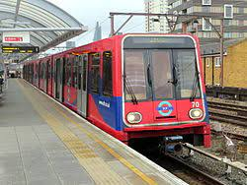
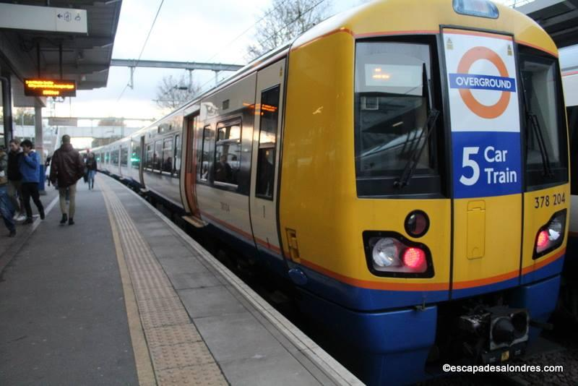
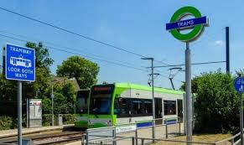
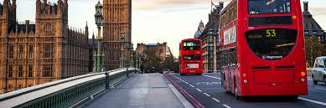
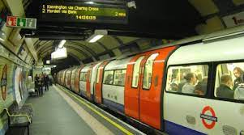
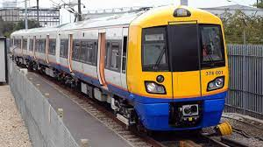
Chp.1 - Introduction (What is about)
Notes:
It would be too pretentious to say I discovered interesting things about TFL for London because I used a public dataset and the graph methods applied are well-known.
The only distinct new factor in this project is my good sense and my creativity that guided through modelling and analyzing a such efficient and complex system of transport.
The main objective is to rank edges relevance. In public system, it is natural that we think in collective relevance, but a single user do not think collectively when choosing how to commute. OK, you opt to bike to reduce CO2 emissions.
You will base you decision in your values but also to why you need to dislocate. But assumes it raining and it is cold and you need to go from A to B. Cost, time, CO2 emission, seated or standing, wi-fi connection … What drives a single users when choosing a path?
Very loosely, let’s say it time. Everyone seeks to spend as least time possible at the transport system. Why? Reason are not hard to be enummerated…
What drives operation when planning?
The sum of single users reflect the collectivity?
Single users opt for new path with minimum time, not to maximize the efficiency?
Firstly, I will apply a disparity filter to rank weighted connection between stations (edges) using a NetworkX.
Secondly, I will use Neo4J to run a lot of shortest path queries to assemble another edge ranking method, considering the same weight metrics.

Slide 2
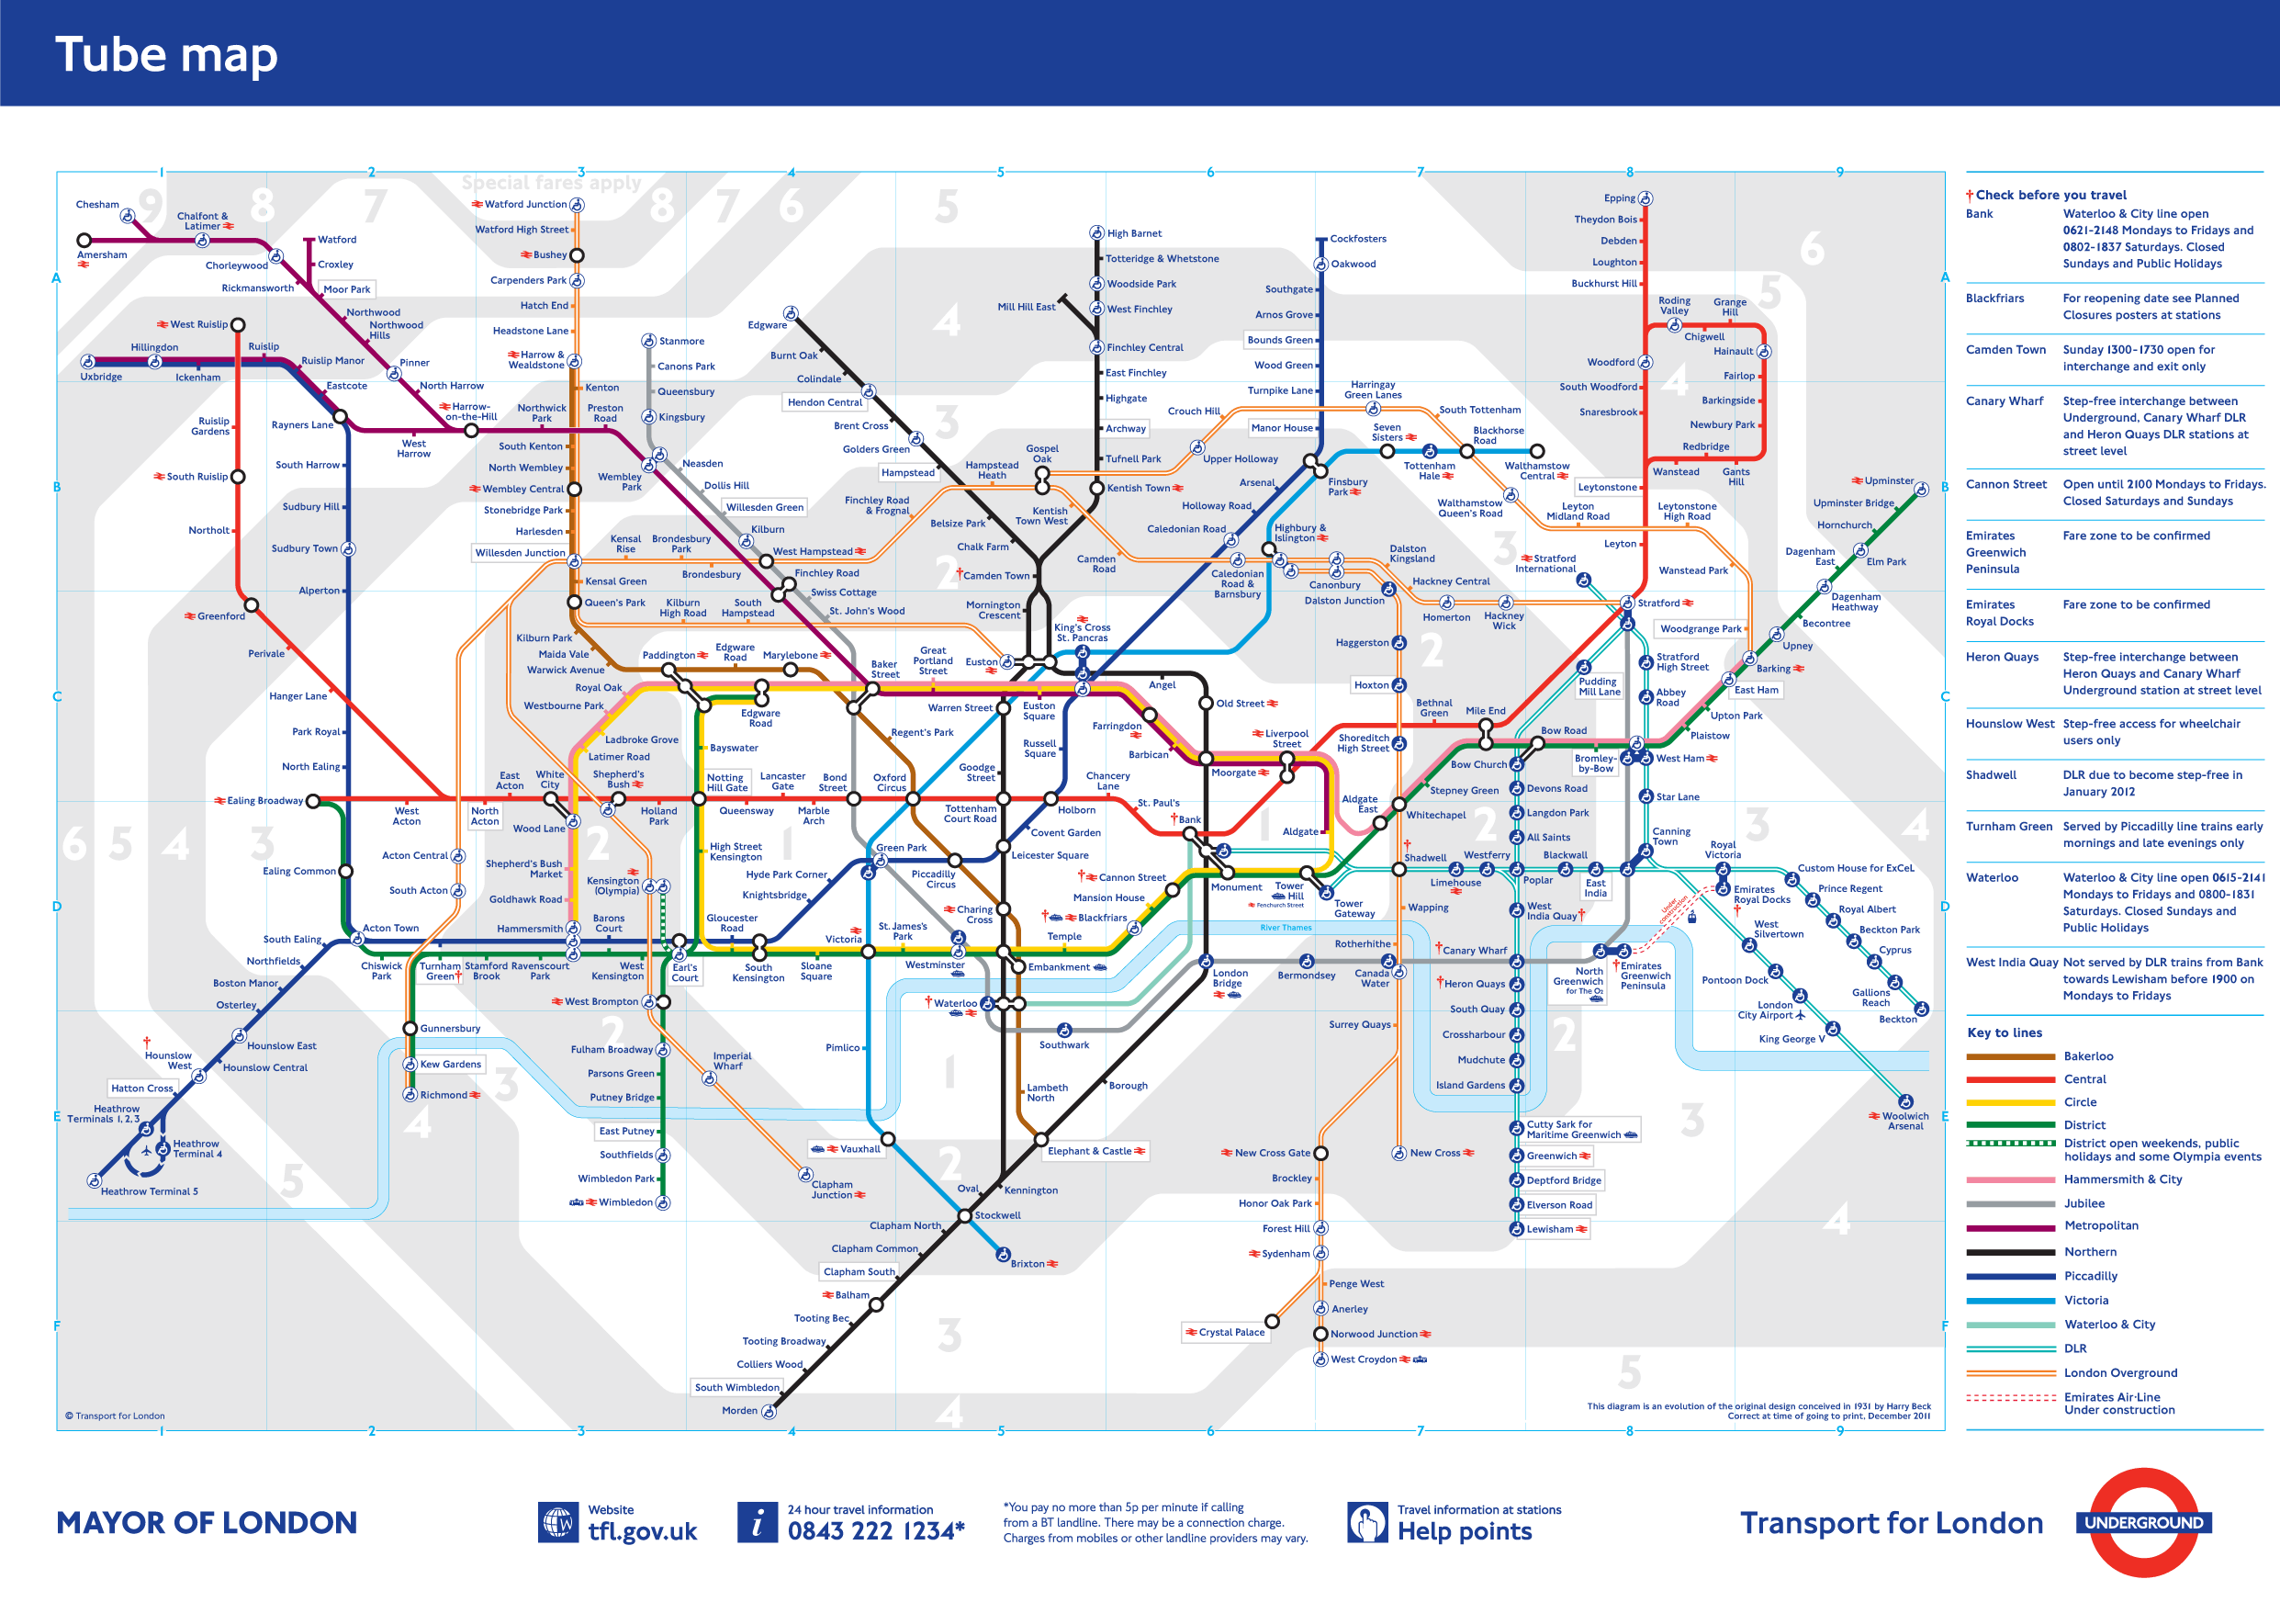
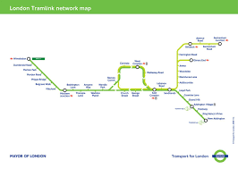
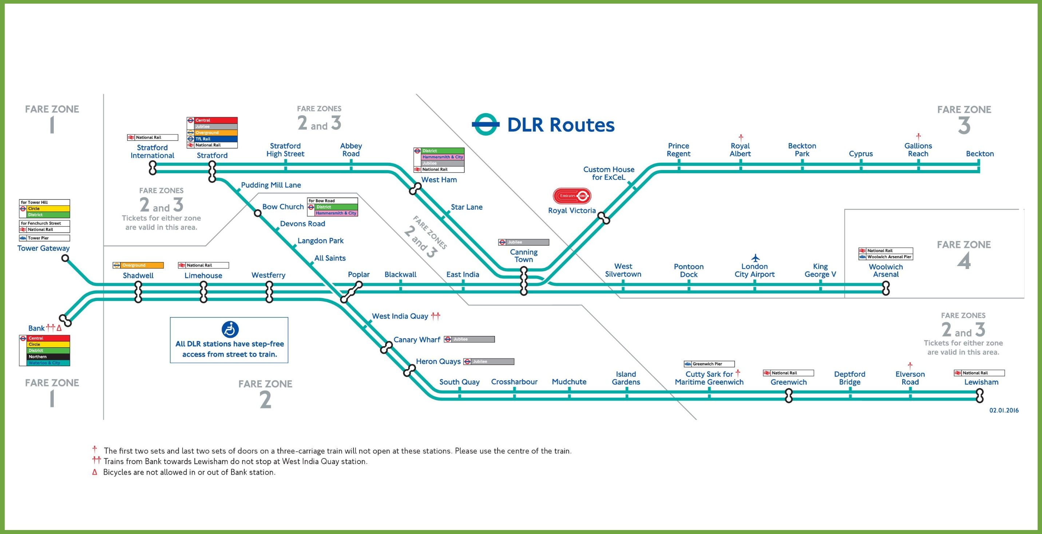
Chp.1 – The problem
Is it possible to have a Systems with plannings (timetable and expansions) dynamically tailored to passenger's need?
TRAFFIC x ENGINEERING = Traffic ⬄ (Infra) x (Operations)
Fully connected
Single rides => More Rides => More Vehicles => More Energy => More CO2 => More Traffic => More TIME
Ideally connected (maps Org/Dest)
Vehicles Load Balance => Less Journeys
Path Redudancy => Less Stress
Notes:
“Before anything, I discovered that plan and operate an efficient transport system demands much more than what takes to use it.”
For that you need to thing in two things: TRAFFIC x ENGINEERING;
Then in three: Traffic ⬄ (Infra) x (Operations)
INFRA: what is the best possible infra-structure to serve the public?
OPERATIONS: what is the best strategy to optimizes the infra-strutures best serving the public?
I can already tell you that I do not have those answers.
A fully connected Net is the most efficient one. However, It has the highiest stress potentiel.

Slide 3
Chp.1 - What I have done
Good sense:
The fastest lane should be those with higher number of passenger.
Service equality responsibility.
Additional cars should provisioned according to a given load.
New lines/routes should meet a efficiency measure that say more people arriving to their destination in less time, with less potential stress and, if possible, less energy consumption.
Data engineering:
- Collected data from TFL Unified API and NUMBAT Project. Combined data-sets from different sources and transformed so it could be modeled.
Data Modelling:
- Used Neo4J and NetworkX to model to run graph theory algorithm.
Data Analysis:
Assemble charts, maps, ranks and used statistics and correlation metrics to evaluate the results.
Conclusion:
- Acquired critic sense about the subject raising technical and moral questions about transport systems.
Notes:
What I have is results of trials which allows to compares different perspectives of a same transport system.
How it behaves in accordance to the day of the week or the time of the day. In other words, how edges relevance change accordingly the amount of people and disposal vehicles.
The speed is also relevant, but it will variate. The numerous interval_id map variety of travel time that a vehicle can reach it destiny based on the weekday and time of the day. I apologize for simplifying some of the meticulous information made available for the TFL.
Those simplification will be detailed in the Data chapter as well as the approaches used to encounter the ranks in the methodology section.
Later I will present and discuss the similarities and discrepancy of ranking methods and the transport system traffic variation. Finally, I also would like to present following steps and comment of the challenge of providing a efficient & equalitarian transportation service.

Slide 4
Chp.2 - Methodology
Disparity Filter:
Normal operation
Traffic pattern/relevance
Collective perspective: Efficiency Rank
Shortest Path:
Disruption
Redundancy of network
Single perspective sommation: Distress Rank
Comparison Method:
Kendall correlation coefficient
Notes:
Ranking Methods:
Disparity Filter (Networkx):
It filters out edges deemed not compatible with a random distribution with a certain statistical significance (alpha).
This manner its possible to encounter different levels of heterogeneities.
Indicator: Efficient Indicator (weight), weight prob. distribution, statistical relevance, node strength, node degree,
Ranks: what are the most relevant edges in Collective angle.
*The disparity filter exploits local heterogeneity and local correlations among weights to extract the network backbone by considering the relevant edges at all the scales present in the system. The methodology preserves an edge whenever its intensity is a statistically not compatible with respect to a null hypothesis of uniform randomness for at least one of the two nodes the edge is incident to, which ensures that small nodes in terms of strength are not neglected. As result, the disparity filter reduces the number of edges in the original network significantly keeping, at the same time, almost all the weight and a large fraction of nodes. As well, this filter preserves the cut-off of the degree distribution, the form of the weight distribution, and the clustering coefficient.
Shortest Path: (Neo4j):
Each edges will be ranked with the possible distress caused by its disruption. It means, the loss of time.
For that, it is necessary to take the user’s perspective. Thanks to NUMBAT dataset, it was possible to statically
recreate the of the user O/D route at each segment.
Indicator: Times (the less possible)
Ranks: what are the most relevant edges in User angle. The ones that saves more journey time.
Comparison Method:
→ Kendall Correlation Coefficient

Slide 5
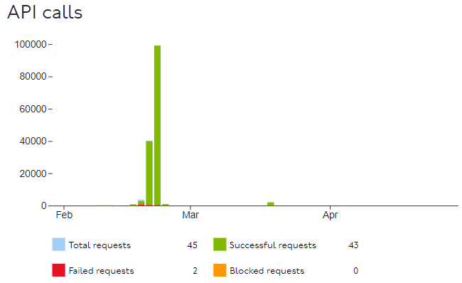

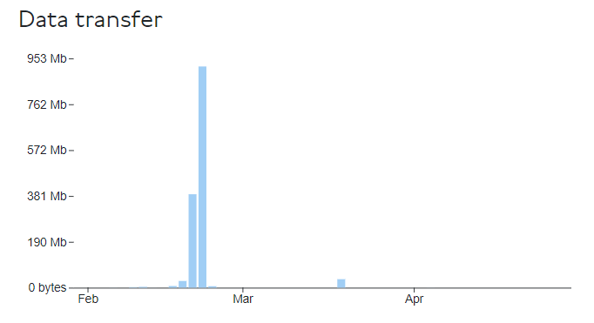
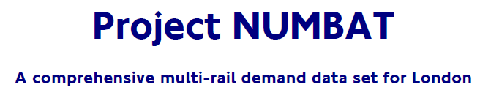
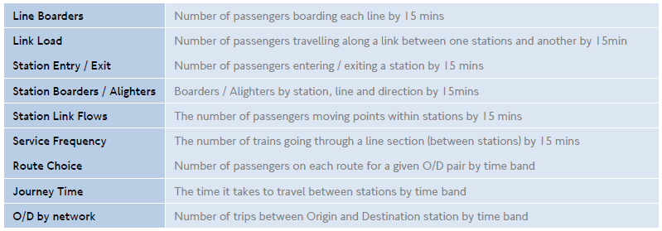
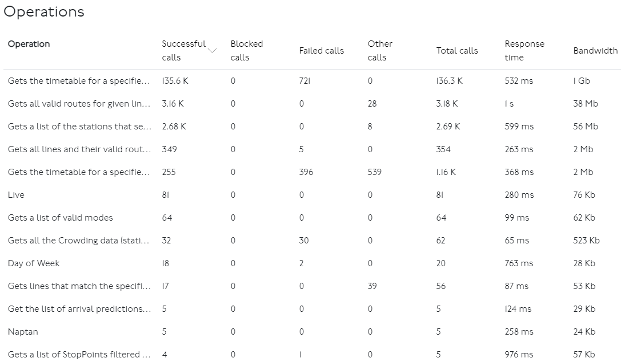
Chp.3 - Data
Notes:
Abou the data, chapter

Slide 6
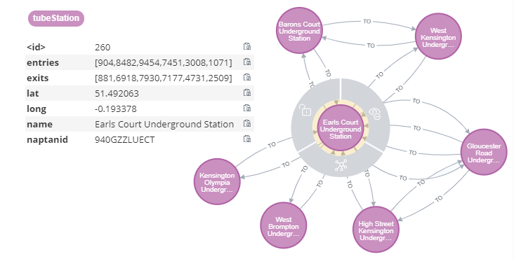
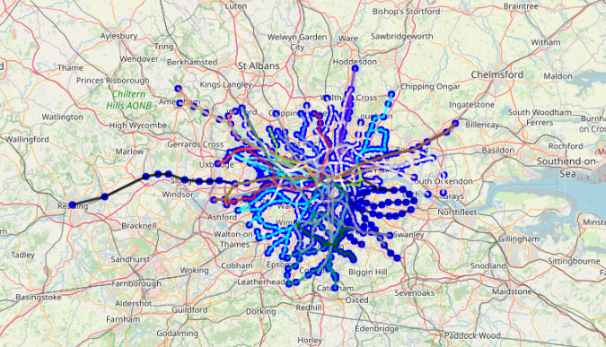
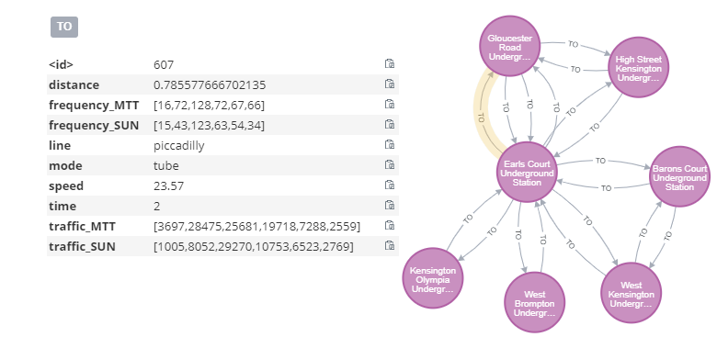
Chp.4 - Modelling

Slide 7
Chp.5 - Results
Operational: Speed & Frequency
Histogram (charts)
Maps (Networkx)
→ Traffic
Enter/Exists in stations (Networkx)
Load in segments (Networkx)
→ User importance:
Disparity ranking comparison
→ Collective importance:
Distress ranking comparison
Notes:
Operational: Speed & Frequency
Histogram (charts) weight
Maps (Networkx)
→ Traffic
Enter/Exists in stations (Networkx)
Load in segments (Networkx)
→ User importance:
Disparity ranking comparison
→ Collective importance:
Distress ranking comparison

Slide 8
Chp.6 - Following Steps
1) Interconnect all possible modes of transport including bikes and walks.
2) Use ML models for predictions of:
TRAFFIC: Passenger flow: From network lens (keeping passenger anonymity) , use more data (daily events) to more accurately understand why traffic is generated in each segments;
OPEX: Predict disruptions and its impact considering forecasted passenger traffic to optimize maintenance planning.
Create a timetable dynamically tailored that optimize infra-structure towards the commuters needs.
CAPEX: More maintenance, less disruptions, less need for redundancy and more investment express lanes (study of origin and destination). A study considering entries and exist of studies.
Notes:
1) Interconnect all possible modes of transport including bikes and walks.
2) Use ML models for predictions of:
TRAFFIC: Passenger flow: From network lens (keeping passenger anonymity) , use more data (daily events) to more accurately understand why traffic is generated in each segments;
OPEX: Predict disruptions and its impact considering forecasted passenger traffic to optimize maintenance planning.
Create a timetable dynamically tailored that optimize infra-structure towards the commuters needs.
CAPEX: More maintenance, less disruptions, less need for redundancy and more investment express lanes (study of origin and destination).

Slide 9
Chp.7 - Conclusion
It is important to mention that a more efficient network inherently requires more maintenance.
It is not necessary related to its size. But is related to how it was projected to assist the commuters.
In a network without disruption, for instance, it would be a waste invest in redundancies. More money could be destinated to reduce travels time.
In a real world, however, no disruptions comes with a high maintenance price.
The balance between effectiveness and robustness is a major question when comes down to a such important factor of the society evolvement.
Notes:
What is a efficient network = minimizes travel time and costs (vehicles, energy, emissions, price) assuring passenger “comfort” and “prompt mobility”.
It is important to mention that a more efficient network inherently requires more maintenance.
It is not necessary related to its size. But is related to how it was projected to assist the commuters.
In a network without disruption, for instance, it would be a waste invest in redundancies. More money could be destinated to reduce travels time.
In a real world, however, no disruptions comes with a high maintenance price.
The balance between effectiveness and robustness is a major question when comes down to a such important factor of the society evolvement.

